Slide 1

Bitcoin Price Trends: A Data Analysis Journey (2018-2025)
Presented by Priyanka on May 5, 2025.

Slide 2

Introduction to Bitcoin
What is Bitcoin?
Bitcoin is a decentralized digital currency (also called a cryptocurrency) that allows people to send and receive money over the internet without the need for a bank or government.
Bitcoin transactions are recorded on a public ledger called a blockchain, which is accessible to anyone.
To access and use your Bitcoin, you need a unique private key, like a secure password.
Launched in
2009
Creator
Satoshi Nakamoto
Symbol
₿ or BTC
Technology
Blockchain
Nature
Decentralized
Why Analyze Bitcoin?
Dataset Overview
High volatility makes it ideal for financial analysis and insights.
Daily prices from 2018 to 2025 including Open, High, Low, Close, and Volume.

Slide 3

Objectives of the Analysis
1
Data Preparation
Load, validate, and clean the dataset for accuracy.
2
Data Exploration
Explore price distributions, correlations, and patterns.
3
Feature Engineering
Create new variables to study trends and volatility.
4
Expected Outcome
Gain clear insights into Bitcoin’s price behavior and market dynamics.

Slide 4
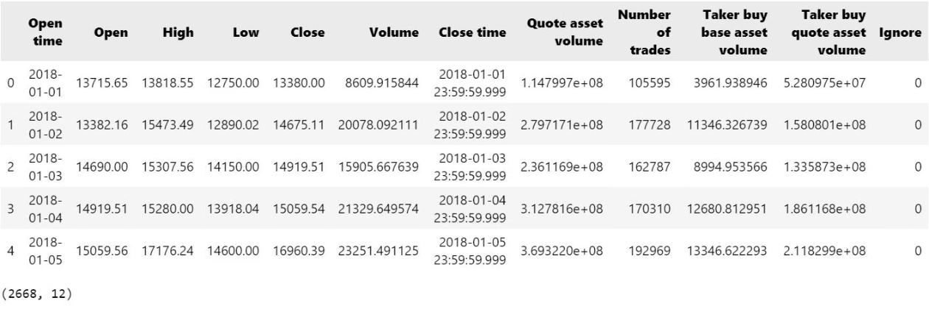
Data Loading
Purpose
Process
The purpose of data loading is to import raw data from various sources (such as CSV files) into a structured and usable format (typically a DataFrame) for analysis and processing in data science
Identify Data Source: Understand where the data is stored: 📂 File (CSV)
Use a tool/library based on the data type and environment. Common libraries: pandas for CSV
✅ Outcome
A clean, structured DataFrame ready for further steps such as exploration, preprocessing, visualization, or modeling.

Slide 5
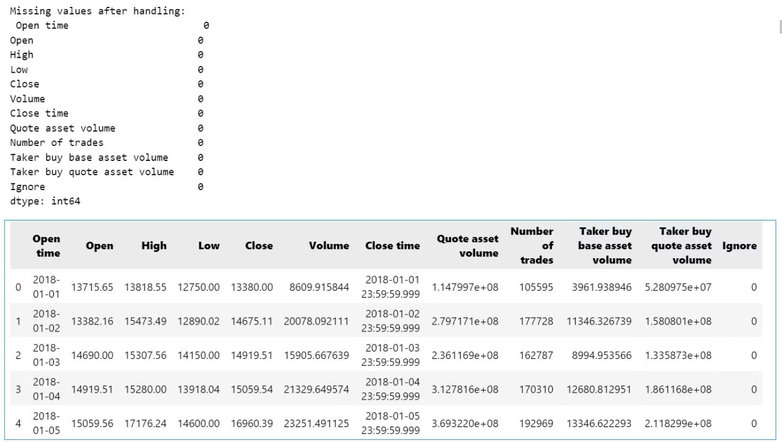
Data Cleaning
Remove Missing Values
Eliminate Duplicates
Fill missing data with most common values to maintain consistency.
Removed duplicate rows to avoid redundancy.
Convert Dates
Outcome
Transformed date strings into proper date formats for analysis.
Clean, reliable dataset ready for exploration and analysis.

Slide 6
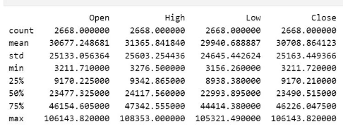
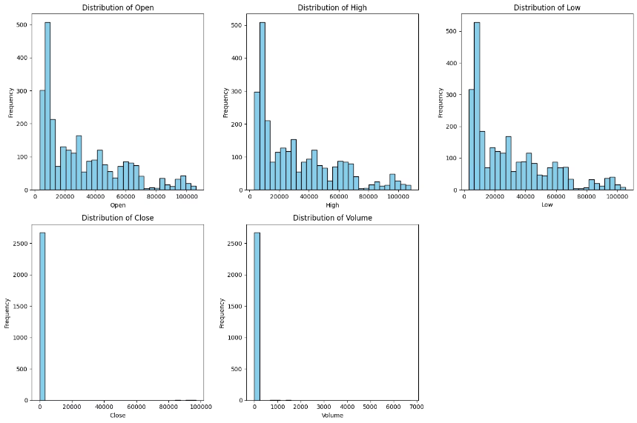
Data Exploration
Examining the data's shape, descriptive statistics, and visualizing the distributions of key features like 'Open', 'High', 'Low', 'Close', and 'Volume'

Slide 7
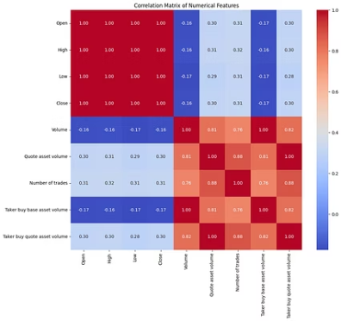
Correlation Analysis
Correlation Table
Key Findings
Insight
Measures strength of relationships between price and volume.
Strong (~0.95) correlation among Open, High, Low, Close prices.
Analysis of the heatmap: Observe the values in the heatmap to identify strong positive and negative correlations. For example, a value close to 1 indicates a strong positive correlation, while a value close to -1 indicates a strong negative correlation. Values close to 0 indicate a weak correlation.

Slide 8
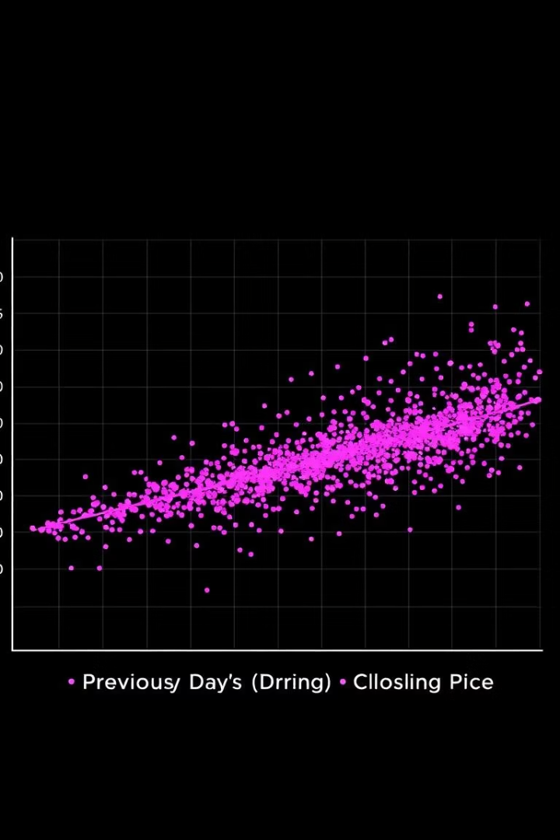
Lagged Price Relationships
Purpose
Findings
Explore how past prices relate to current prices.
High (~0.98) correlation between today’s and yesterday’s Close prices.
Scatter plot reveals near-linear relationship.
Insight
Past prices strongly predict short-term future prices.

Slide 9
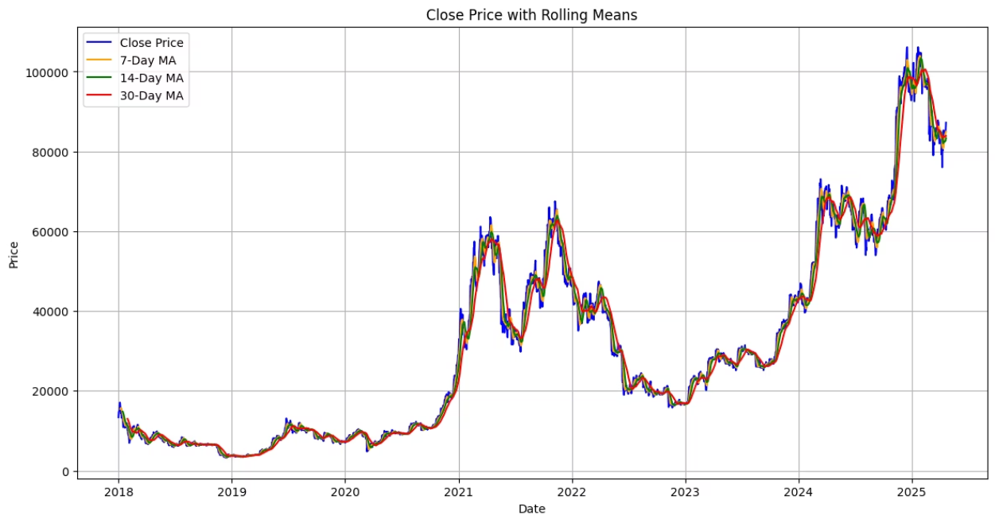
Feature Engineering
New Features
Percentage Change: daily price change in %
Moving Averages: 7-day average to smooth trends
Example: If the closing price on day 1 is $10,000 and on day 2 it's $$10,000 and on day 2 it's $10,500, the percentage change is (10500 - 10000) / 10000 = 0.05 or 5%.
Features help identify trends and predict movements.

Slide 10
Statistical Analysis
Purpose: Analyze trends and volatility quantitatively.
Methods:
Calculate rolling averages to track long-term trends.
Rolling means and standard deviations of prices (such as Close_7d) over different time windows (e.g., 7 days, 30 days) to analyze trends and volatility.
Compute rolling standard deviation to measure volatility.

Slide 11
Key Findings
Data Quality: Cleaned missing values and duplicates for reliable analysis.
Volume: Spikes in trading volume align with price volatility.
Correlations: Strong links between price components and volume.

Slide 12
Conclusion
Analyzed Bitcoin price data (2018-2025) through cleaning, exploration, and statistical methods.
Uncovered trends, correlations, and volatility patterns.
Takeaway: Bitcoin’s market is dynamic, with opportunities for informed decision-making through data analysis.

Slide 13
Thank You!

